Slide 1
CSEE 5590/490 Big Data Programming Lesson 6 Apache Lucene Apache Solr

Slide 2
Overview
Apache Lucene
Apache Solr

Slide 3

Apache Lucene

Slide 4
Apache Lucene Highlights
Fast, high performance, scalable search/IR library
Open source
Initially developed by Doug Cutting (Also author of Hadoop)
Indexing and Searching
Inverted Index of documents
Provides advanced Search options like synonyms, stopwords, based on similarity, proximity.
http://lucene.apache.org/

Slide 5
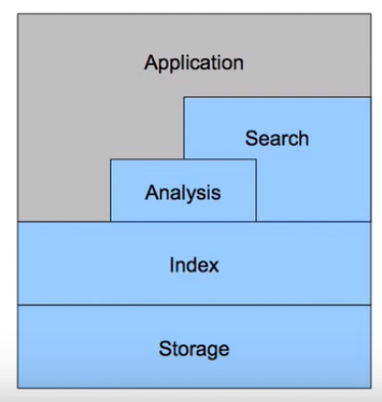
Lucene - Architecture

Slide 6
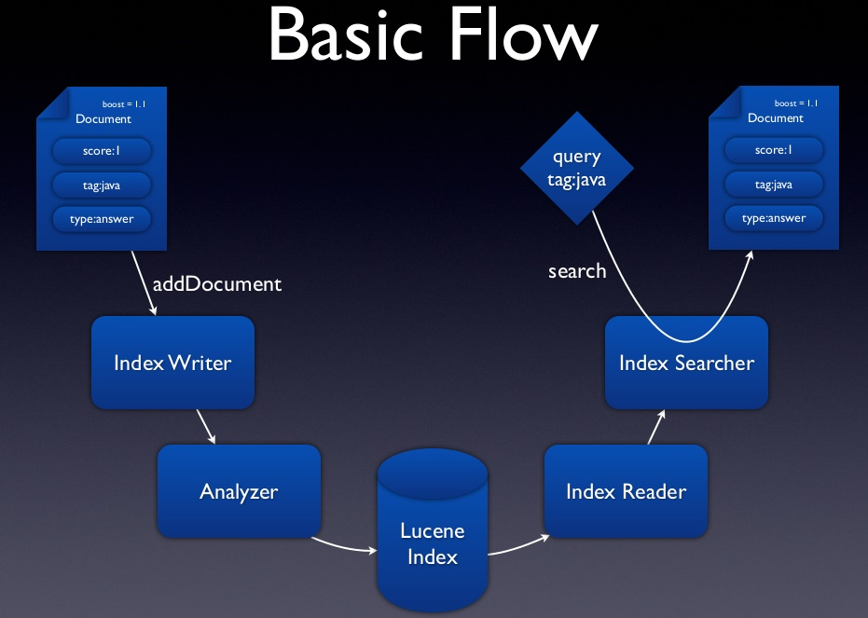
Lucene – Work Flow

Slide 7
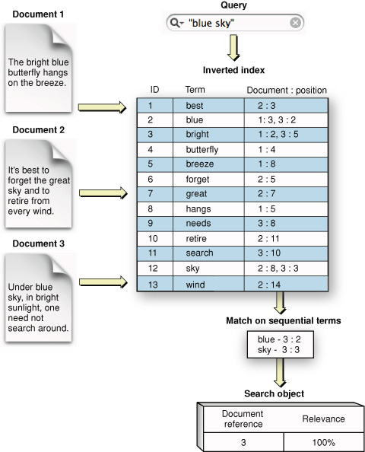
Lucene Internals - Inverted Index
Credit: https://developer.apple.com/library/mac/documentation/userexperience/conceptual/SearchKitConcepts/searchKit_basics/searchKit_basics.html

Slide 8
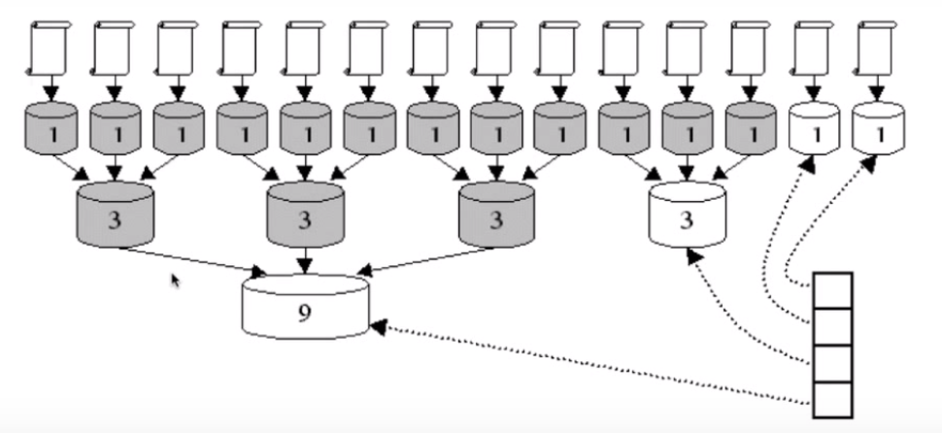
Lucene - Indexing

Slide 9
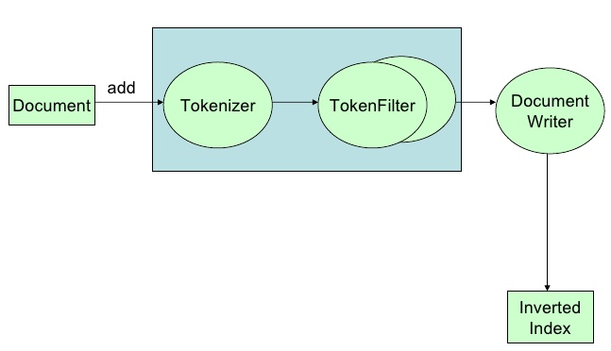
Indexing Pipeline
Analyzer : create tokens using a Tokenizer and/or applying Filters (Token Filters)
Each field can define an Analyzer at index time/query time or the both at same time.
Credit : http://www.slideshare.net/otisg/lucene-introduction

Slide 10
Analysis Process - Tokenizer
WhitespaceAnalyzer
Simplest built-in analyzer
The quick brown fox jumps over the lazy dog.
[The] [quick] [brown] [fox] [jumps] [over] [the] [lazy] [dog.]
Tokens

Slide 11
Analysis Process - Tokenizer
SimpleAnalyzer
Lowercases, split at non-letter boundaries
The quick brown fox jumps over the lazy dog.
[The] [quick] [brown] [fox] [jumps] [over] [the] [lazy] [dog.]
Tokens

Slide 12
Some common analyzer
WhitespaceAnalyzer : Splits text at whitespaces, just as the name indicates. In fact, this is the only thing this analyzer does.
SimpleAnalyzer : Splits text at non-letter characters and lowercases resulting tokens.
StopAnalyzer : Splits text at non-letter characters, lowercases resulting tokens, and removes stopwords.
StandardAnalyzer : Splits text using a grammar-based tokenization, normalizes and lowercases tokens, removes stopwords, and discards punctuations. It can be used to extract company names, e-mail addresses, model numbers, and so on. This analyzer is great for general usage.
SnowballAnalyzer: This analyzer is similar to StandardAnalyzer with an additional SnowballFilter for stemming.

Slide 13

Apache Solr

Slide 14
Apache Solr
Created by Yonik Seeley for CNET
Enterprise Search platform for Apache Lucene
Open source
Highly reliable, scalable, fault tolerant
Support distributed Indexing (SolrCloud), Replication, and load balanced querying
http://lucene.apache.org/solr

Slide 15
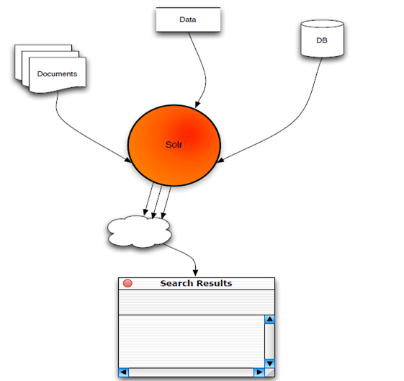
High level overview
Source: http://www.slideshare.net/erikhatcher/solr-search-at-the-speed-of-light

Slide 16
Apache Solr - Features
Full-text search
Faceted search (similar to groupby clause in RDBMS)
Scalability
Caching
Replication
Distributed search
Near real-time indexing
Geospatial search
And many more : highlighting, database integration, rich document (e.G., Word, PDF) handling

Slide 17
Solr – schema.xml
Types with index and query Analyzers - similar to data type
Fields with name, type and options
Unique Key : Unique Identifier of a document. For e.g. “id”
Dynamic Fields : Dynamic fields allow Solr to index fields that you did not explicitly define in your schema. For e.g. fieldName: *_i or *_txts
Copy Fields : Solr has a mechanism for making copies of fields so that you can apply several distinct field types to a single piece of incoming information. field ‘a‘ populates field ‘b’ with its value before tokenizing (having different analyzer/filter).

Slide 18
Solr – Content Analysis
Field Attributes
Name : Name of the field
Type : Data-type (FieldType) of the field
Indexed : Should it be indexed (indexed="true/false")
Stored : Should it be stored (stored="true/false")
Required : is it a mandatory field (required="true/false")
Multi-Valued : Would it will contains multiple values e.g. text: pizza, food (multiValued="true/false")
e.g. <field name="id" type="string" indexed="true" stored="true" required="true" multiValued="false" />

Slide 19
Solr – solrconfig.xml
Data dir: where all index data will be stored
Index configuration
Cache configurations
Request Handler configuration
Search components, response writers, query parsers

Slide 20
Query Types
Single and multi term queries
ex fieldname:value or title: software engineer
+, -, AND, OR NOT operators.
ex. title: (software AND engineer)
Range queries on date or numeric fields,
ex: timestamp: [ * TO NOW ] or price: [ 1 TO 100 ]
Boost queries:
e.g. title:Engineer ^1.5 OR text:Engineer
Fuzzy search : is a search for words that are similar in spelling
e.g. roam~0.8 => noam
Proximity Search : with a sloppy phrase query. The close together the two terms appear, higher the score.
ex “apache lucene”~20 : will look for all dcuments where “apache” word occurs within 20 words of “lucene”

Slide 21
Solr/Lucene Use-cases
Search
Analytics
NoSQL datastore
Auto-suggestion / Auto-correction
Recommendation Engine (MoreLikeThis)
Relevancy Engine (Feedback to other applications)
Solr as a White-List
GeoSpatial based Search

Slide 22
Search
Application
Eclipse, Hibernate search
E-Commerce :
Flipkart.com, Infibeam.com, Buy.com, Netflix.com, ebay.com
Jobs
Indeed.com, Simplyhired.com, Naukri.com
Auto
AOL.com
Travel
Cleartrip.com
Social Network
Twitter.com, LinkedIn.com, mylife.com
Source: http://www.quora.com/Which-major-companies-are-using-Solr-for-search

Slide 23
Search (Contd.)
Search Engine
Yandex.ru, DuckDuckGo.com
News Paper
Guardian.co.uk
Music/Movies
Apple.com, Netflix.com
Events
Stubhub.com, Eventbrite.com
Cloud Log Management
Loggly.com
Others
Whitehouse.gov

Slide 24
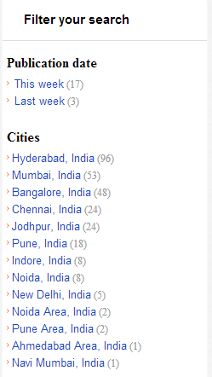
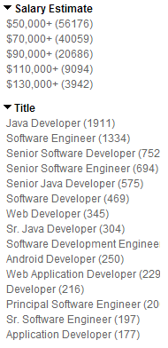
Faceting
Grouping results based on field value
Facet on: field terms, queries, date ranges
&facet=on &facet.field=job_title
&facet.query=salary:[30000 TO 100000]
http://wiki.apache.org/solr/SimpleFacetParameters
Source: www.career9.com, www.indeed.com

Slide 25
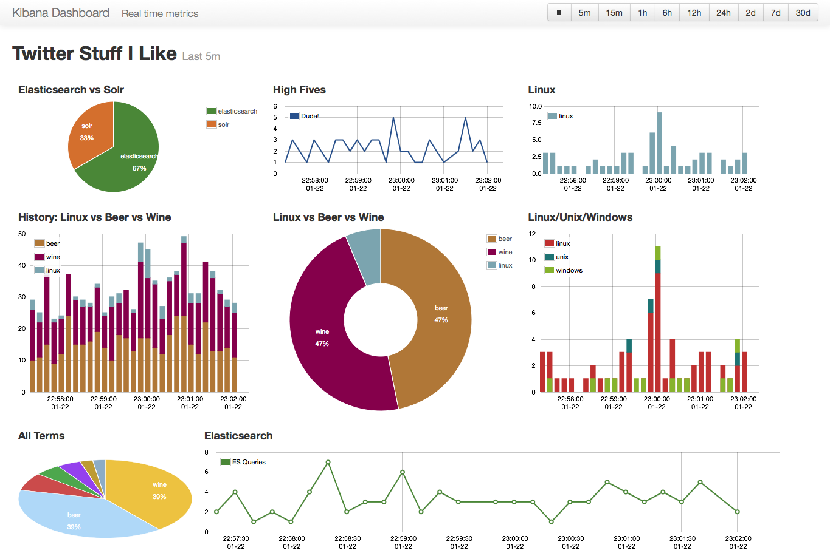
Analytics
Analytics source : Kibana.org based on ElasticSearch and Logstash
Image Source : http://semicomplete.com/presentations/logstash-monitorama-2013/#/8

Slide 26
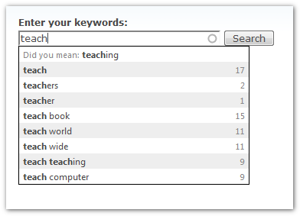
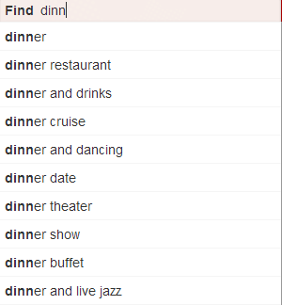
Autosuggestion
Source: www.drupal.org , www.yelp.com

Slide 27
Integration
Clustering (Solr-Carrot2)
Named Entity extraction (Solr-UIMA)
SolrCloud (Solr-Zookeeper)
Parsing of many Different File Formats (Solr-Tika)
Machine Learning/Data Mining (Apache Mahout)
Large scale Indexing (Hadoop)

Slide 28
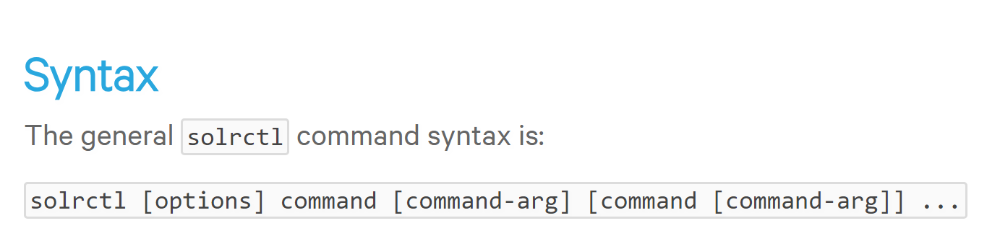
SolrCtl Command
The solrctl utility is a wrapper shell script included with Cloudera Search for managing collections, instance directories, configs, Apache Sentry permissions, and more.
Source: https://www.cloudera.com/documentation/enterprise/5-14-x/topics/search_solrctl_ref.html

Slide 29
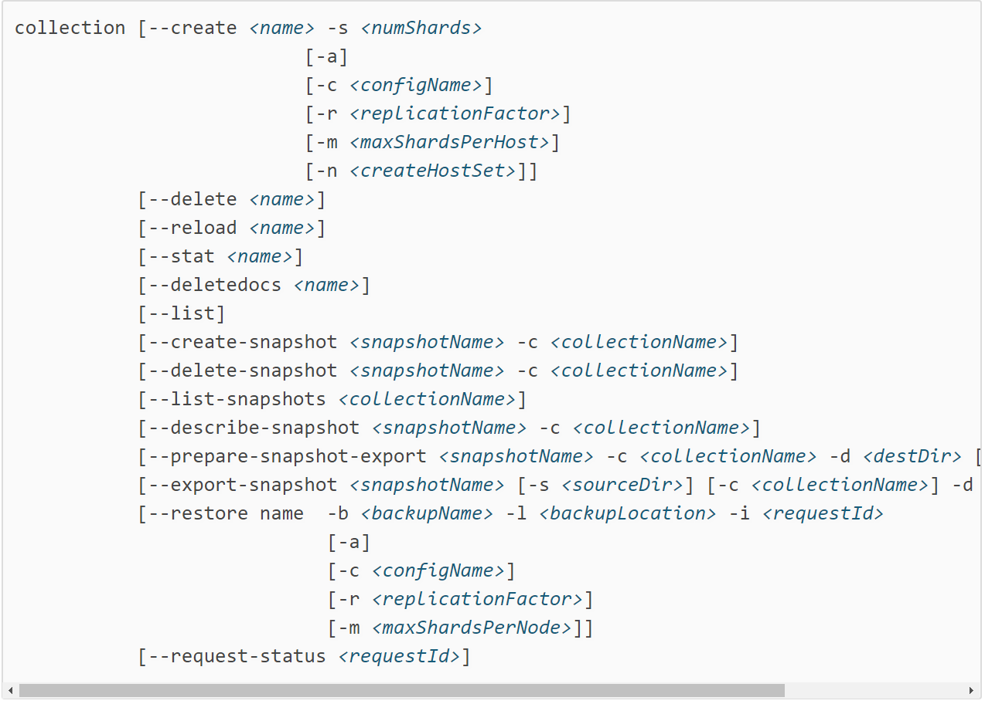
SolrCtl Collection Commands
Source: https://www.cloudera.com/documentation/enterprise/5-14-x/topics/search_solrctl_ref.html

Slide 30
solrctl collection –list
Lists the collection
solrctl config --create logs_config predefinedTemplate -p immutable=false
logs_config => config name
predefinedTemplate => existing config template
solrctl instancedir --generate $HOME/logs_config
solrctl collection --create logNew2 -c logs_config
logNew2 => collection Name

Slide 31
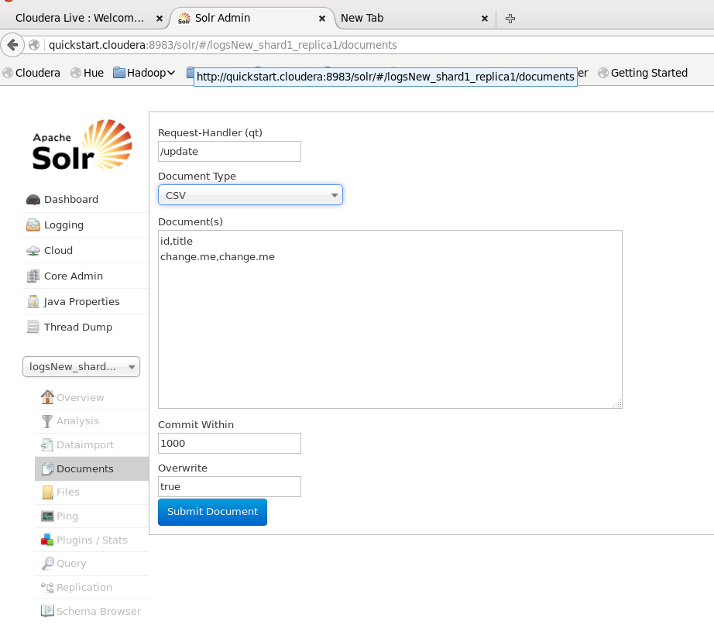
Update or add data to collection

Slide 32
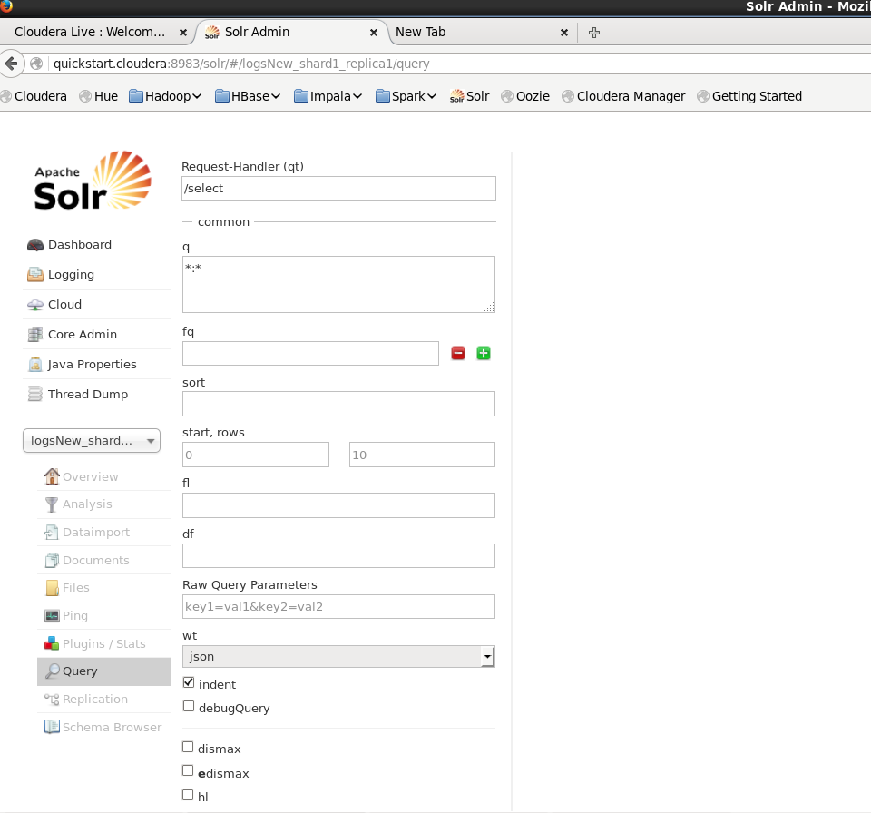
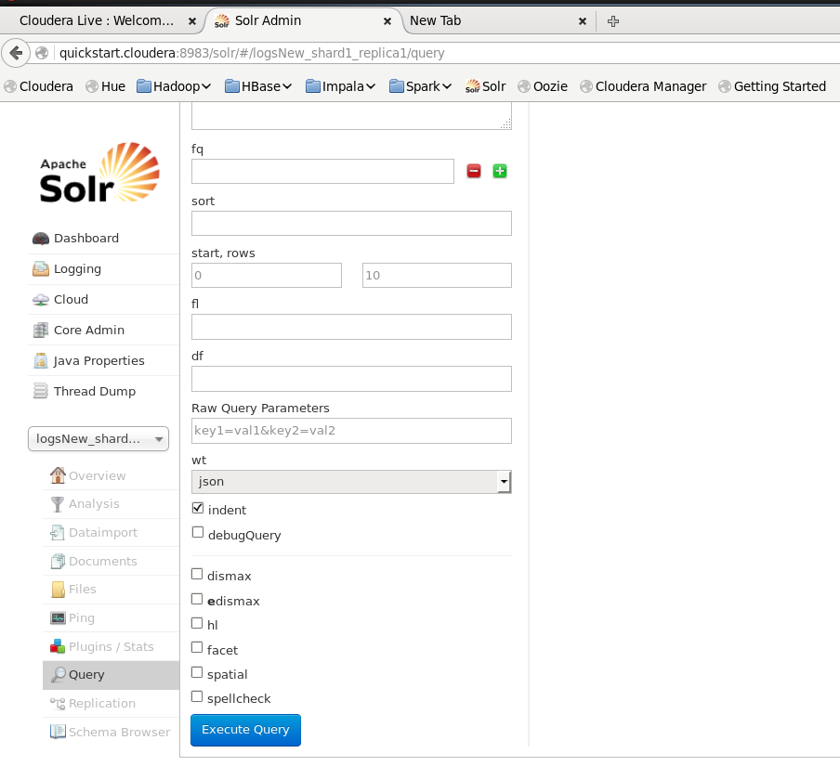
Query Syntax

Slide 33
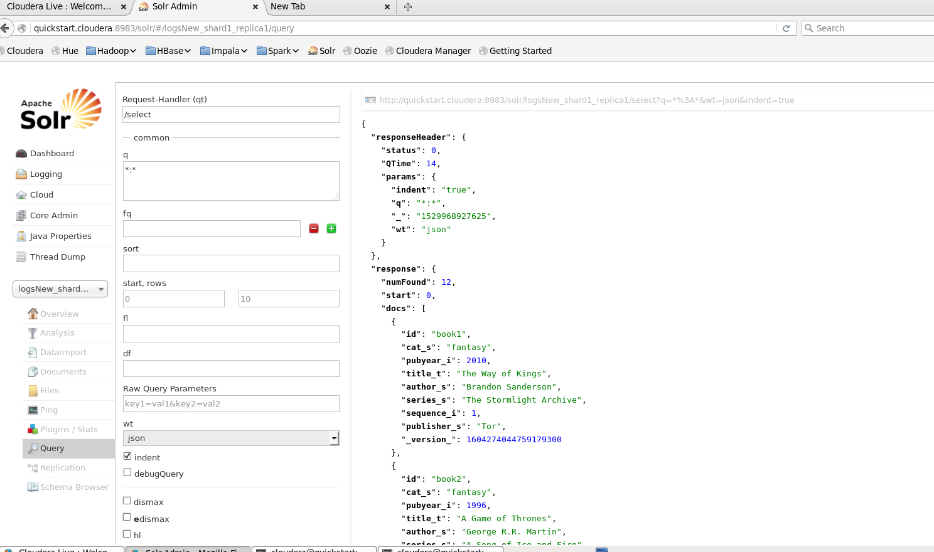
Results

Slide 34
Creating Schema Config
solrctl instancedir --generate /tmp/films

Slide 35
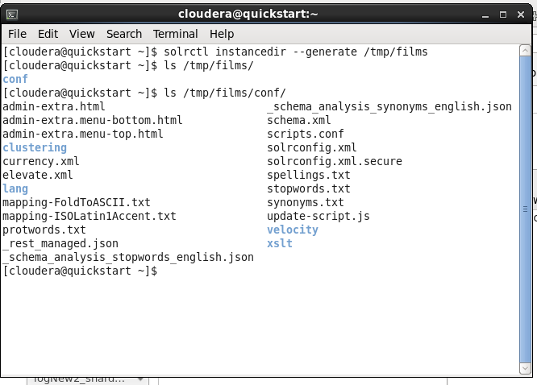
Editing Schema Config

Slide 36
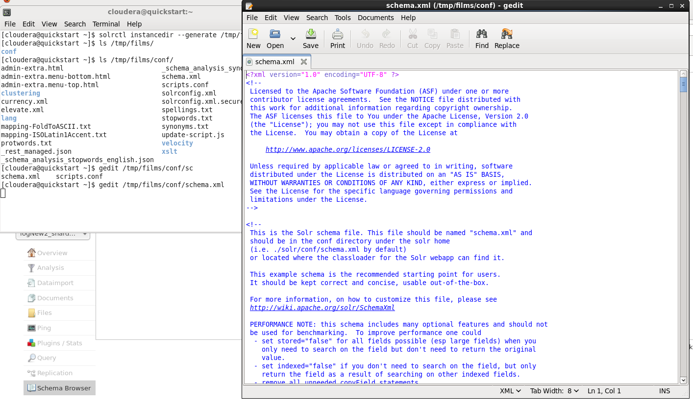
Editing Schema Config : gedit /tmp/films/conf/schema.xml

Slide 37
Creating new fieldType (Use this to create your own directed_by field)
http://www.solrtutorial.com/schema-xml.html
<fields> <field name="id" type="string" indexed="true" stored="true" required="true" /> <field name="name" type="textgen" indexed="true" stored="true"/> ... </fields>

Slide 38
Film Dataset commands
Instancedir and collection
solrctl instancedir --create films /tmp/films
solrctl collection --create films
Edit Schema
ls /tmp/films/conf/
gedit /tmp/films/conf/schema.xml

Slide 39
References
http://www.lucenetutorial.com/lucene-vs-solr.html
https://lucene.apache.org/solr/
https://lucene.apache.org/solr/guide/6_6/the-standard-query-parser.html

Slide 40
Commands Details
solrctl instancedir -- generate - Use this command to generate new instance.
solrctl instancedir -- create <collection_name> - To upload the contents of instance directory to Zookeeper.
solrctl collection -- create <collection_name> - Used to create new collection.

Slide 41
Commands
solrctl config --create logs_config predefinedTemplate -p immutable=false
solrctl instancedir --generate $HOME/logs_config
solrctl collection --create logNew2 -c logs_config
solrctl instancedir --generate /tmp/films
ls /tmp/films/conf

